Slide 1
Monaco: Quantify Uncertainty and Sensitivities in Your Computational Models with a Monte Carlo Library
SciPy 2022 Conference
Machine Learning and Data Science Track
Scott Shambaugh
Notes:
Thanks for coming
Explain title
What hope to get: why important, crash course on how to use tool

Slide 2


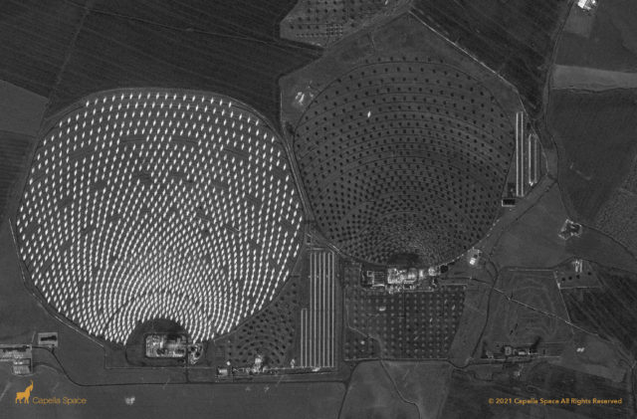

Acknowledgements
Thank you to Capella Space for sponsoring this talk

Slide 3
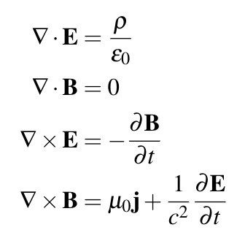
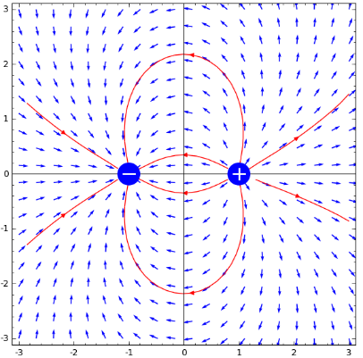
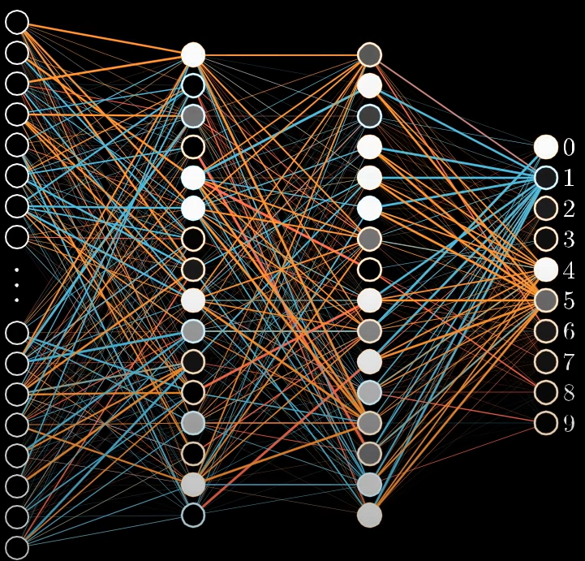

Mechanistic vs Empirical Models
Deterministic
Debuggable & Auditable
Encodes Human Knowledge
No Need for Training Data
Easy to Implement → Used Everywhere
“Too Perfect”
Real world is noisy and messy!
How sensitive are these predictions?
What’s the range of outcomes?
Inputs
Model
Predictions
Decisions
Crucial for effective & responsible use of models in decision-making

Slide 4




Best Point Estimate
Input Space
Variable 2
Here be dragons!
Variable 1

Slide 5

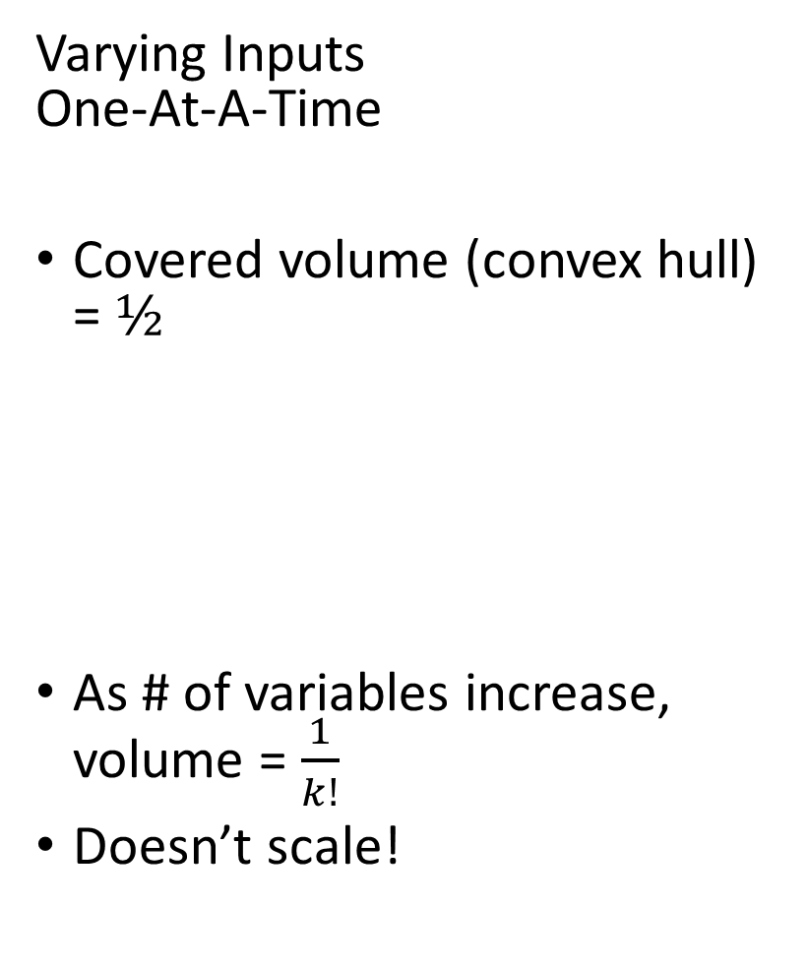
Varying Inputs One-At-A-Time
Covered volume (convex hull) = $½$
As # of variables increase, volume = $\frac{1}{k!}$
Doesn’t scale!
Input Space
Variable 2
Here still be dragons!
Variable 1

Slide 6
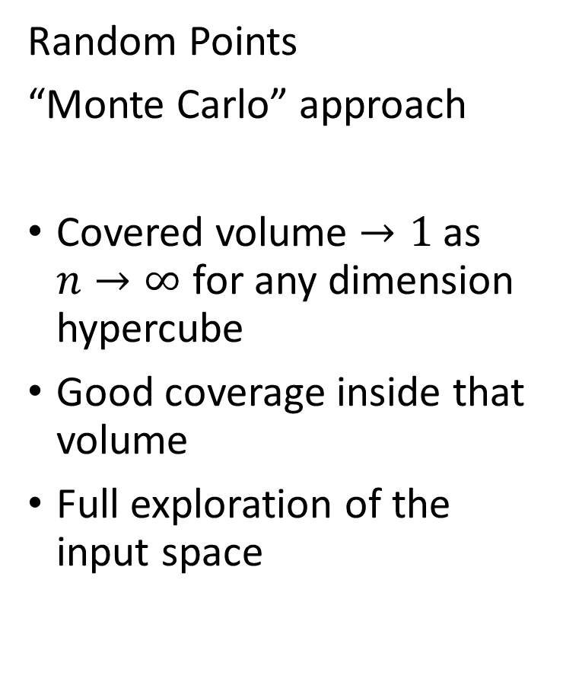
Random Points
“Monte Carlo” approach
Covered volume $→1$ as $n→∞$ for any dimension hypercube
Good coverage inside that volume
Full exploration of the input space
Input Space
Variable 2
Variable 1

Slide 7

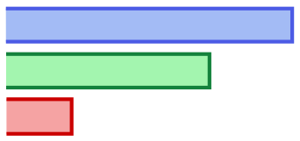
Uncertainty & Sensitivity Analysis
“What is the range of possible outcomes?”
“Which parameters most affect these outcomes?”
Uncertainty Analysis
Histograms
Spaghetti Plots
Confidence Intervals
Sensitivity Analysis
Scatter Plots
Sensitivity Indices
Regressions

Slide 8
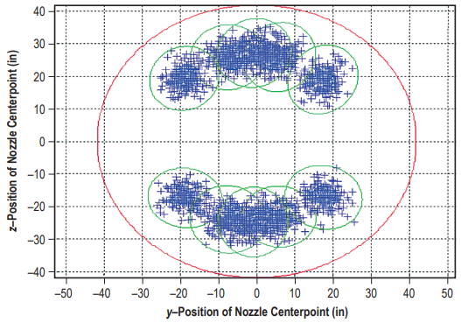
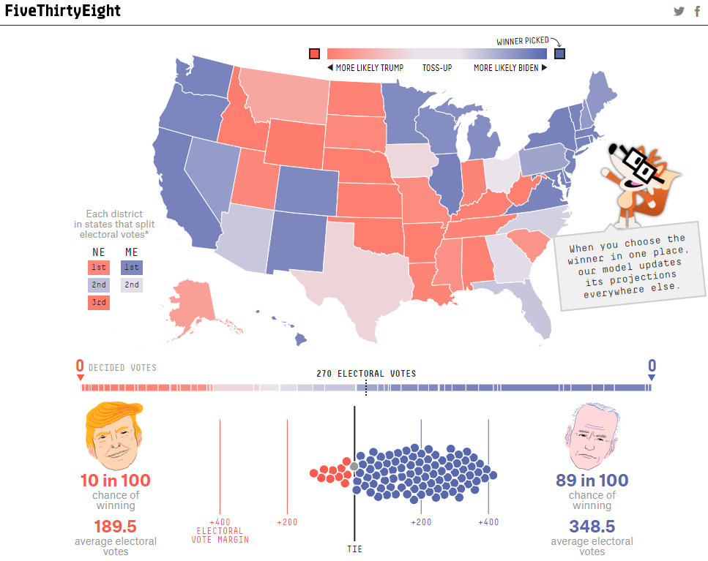
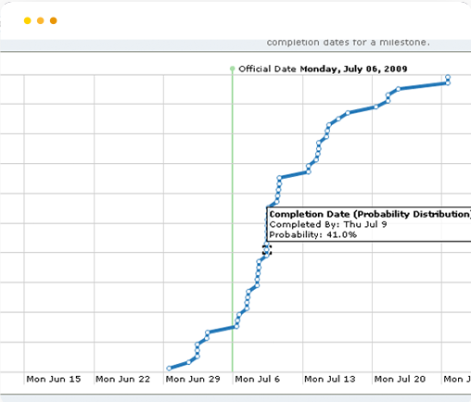
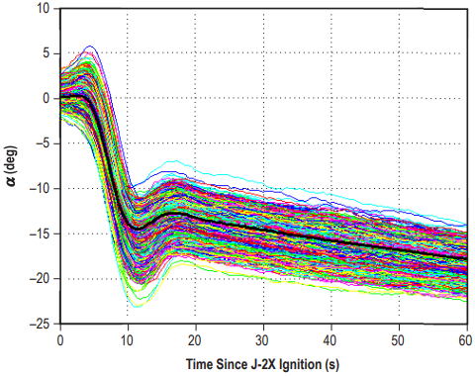
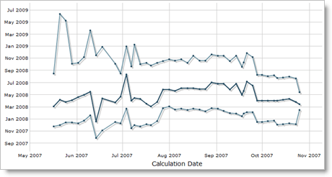
What this looks like in practice
NASA: Ares I Flight Simulations
FiveThirtyEight: Election Forecasting
FogBugz: Evidence-Based Scheduling

Slide 9
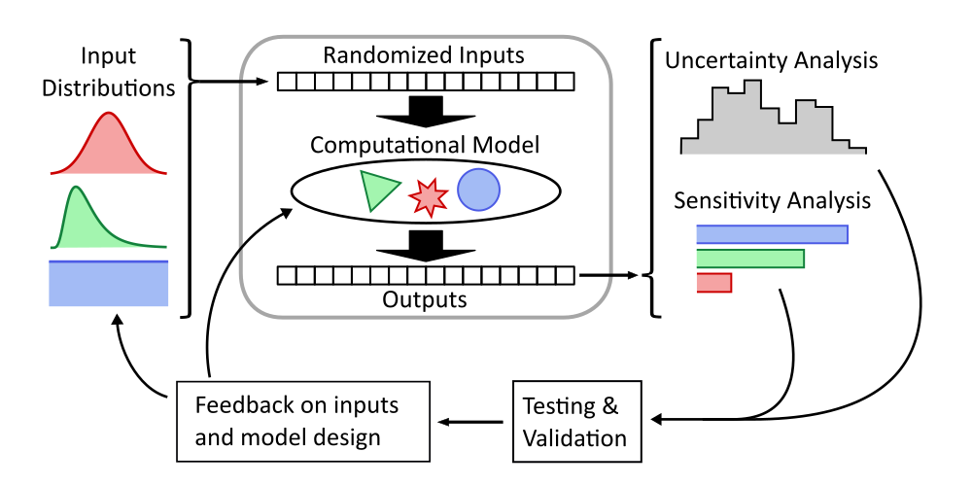

Workflow
Forward
Uncertainty
Propagation
Model & Parameter Validation

Slide 10
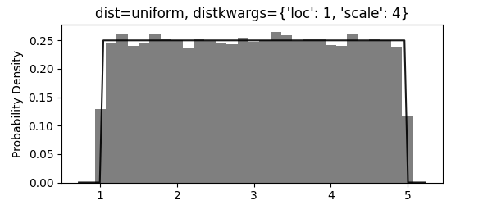
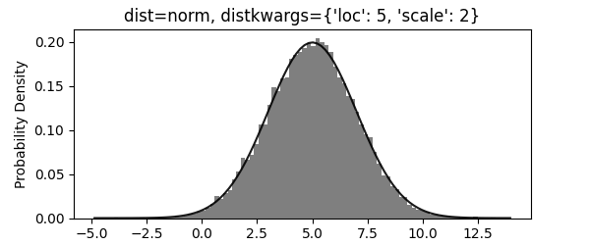
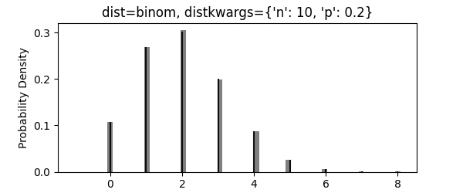
Workflow – Input Distributions
Pass in any of scipy.stats’ probability distributions
Or, define a custom one
Input ranges come from:
Observed / experimental data
Physical limits
Spec sheets
Best guesses

Slide 11
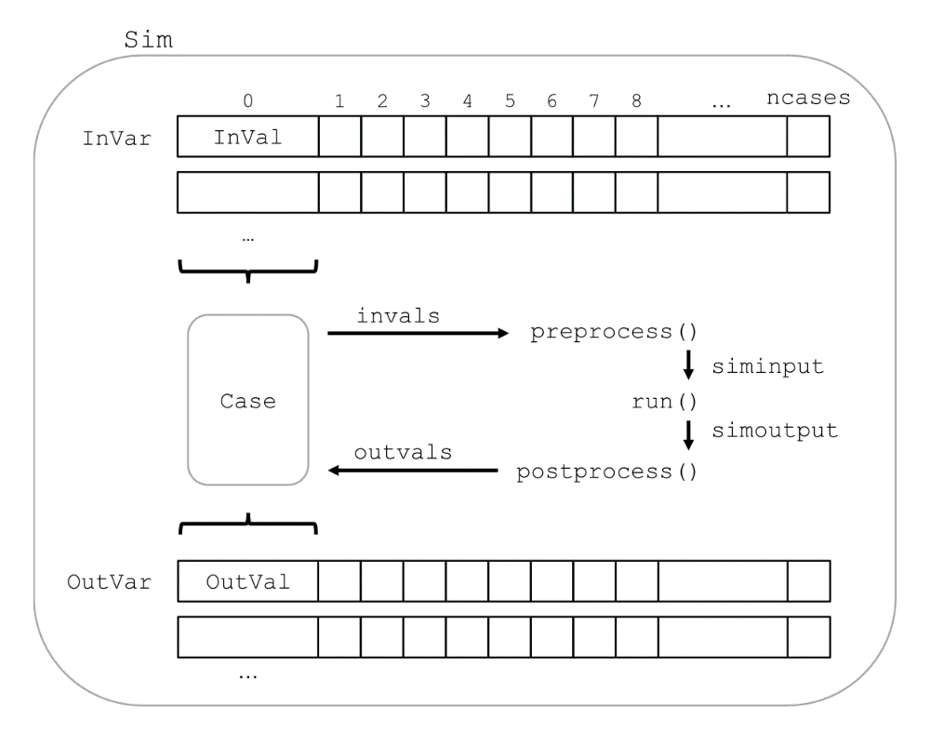

Workflow – Simulation Structure
3 User-Defined Functions
Preprocess
Grabs input values from each case, structures it into format run expects
Run
Wraps or directly implements your model
Postprocess
Grabs raw outputs from run function and extracts output values for each case

Slide 12
Workflow – Analyzing Results
Plotting!
monaco.plot() on one or more Vars will automatically choose best plot type to show
Histograms, empirical CDFs, 2D/3D scatter plots, 2D/3D spaghetti plots
Variable Statistics
Calculate mean, percentiles, etc, or any custom statistic
Bootstrapped to specified confidence levels
Sensitivity Indices
Measures contribution to output variance from variance of inputs
Includes first-order as well as nonlinear interaction effects

Slide 13
Live Demo: Dice Roll github.com/scottshambaugh/monaco-scipy2022/blob/main/dice_roll.ipynb

Slide 14
Live Demo: Baseball github.com/scottshambaugh/monaco-scipy2022/blob/main/baseball.ipynb

Slide 15

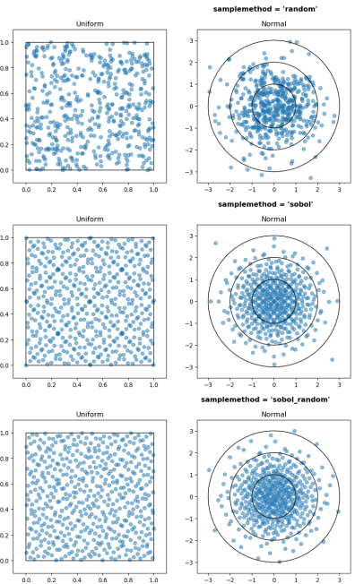
Workflow – Other Features
Parallel Processing
Run workflow serially or in parallel with dask.distributed
How Many Cases to Run?
Order statistics determine cases needed to rigorously reach confidence level for variable statistics
File I/O
Save and load Sim and Case objects to file to avoid repeating expensive computations
Import and export variables to .csv or .json to trade out any part of the workflow with external tooling
Quasi Monte-Carlo Sampling
Fills space more efficiently than pure random sampling

Slide 16
Model & Parameter Validation
Very important, but genuinely difficult
A rigorous treatment requires:
Lots of test data
Moving to a full probabilistic programming framework
A more typical treatment looks like:
Subject matter expert validates model behavior (corners of input space often reveal bugs!)
Input parameters are anchored and defined conservatively
A small family of test data is compared to expected results
Can formalize with hypothesis testing or probabilistic scoring measures
Outside monaco’s scope

Slide 17



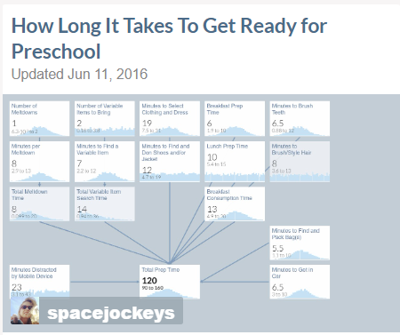
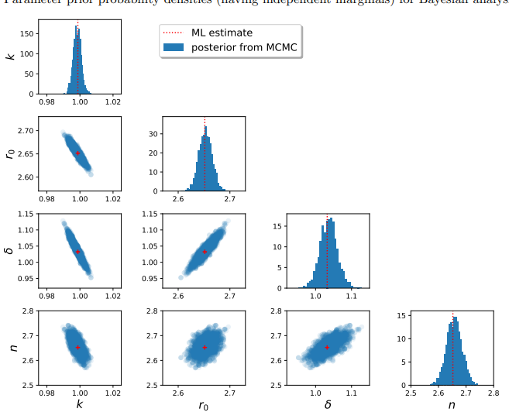
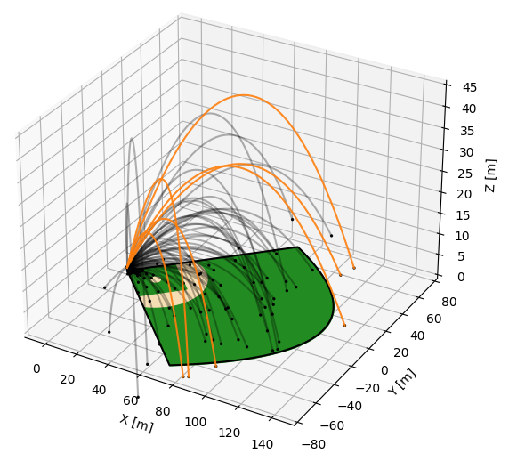

Recommended Tools
Basic
Advanced
Guesstimate
Web-based tool for simple models
Monaco
Single-Shot Uncertainty & Sensitivity Analysis
UQpy
More Advanced Uncertainty & Sensitivity Analysis
Stan, PyMC
Probabilistic Programming

Slide 18
Miscellanea
Links
Project repo: github.com/scottshambaugh/monaco
Lots of examples: github.com/scottshambaugh/monaco/tree/main/examples
API Documentation: monaco.readthedocs.io
Conference paper: conference.scipy.org/proceedings/scipy2022/pdfs/scott_shambaugh.pdf
These slides and notebooks: github.com/scottshambaugh/monaco-scipy2022
Video of conference talk: youtube.com/watch?v=yB539OIol_s
Recommended Reading:
“Applying Monte Carlo Simulation to Launch Vehicle Design and Requirements Analysis”
“The Future of Sensitivity Analysis: An essential discipline for systems modeling and policy support”
“Why so many published sensitivity analyses are false: A systematic review of sensitivity analysis practices”
Short-Term Roadmap – currently alpha software
Single variable and pairwise regressions: linear, polynomial, custom, with confidence intervals
Sensitivity Indices: confidence intervals and scale-dependent effects
Dask: link task graph and confirm working on remote server
Pairwise variable statistics
pip install monaco

Slide 19
Thank You Questions?

Slide 20
Image Sources
https://www.capellaspace.com/
https://www.youtube.com/watch?v=IHZwWFHWa-w
https://www.cantorsparadise.com/maxwells-equations-7484212839b1
http://www.cs.cornell.edu/courses/cs4670/2016sp/lectures/lec41_recowrapup_web.pdf
https://en.wikipedia.org/wiki/File:Reggio_calabria_museo_nazionale_mosaico_da_kaulon.jpg
https://en.wikipedia.org/wiki/Dragon#/media/File:M%C3%BCnster_wawelski.jpg
https://commons.wikimedia.org/wiki/File:Psalter_World_Map,_c.1265_dragons.jpg
https://commons.wikimedia.org/wiki/File:20000_squid_holding_sailor.jpg
https://ntrs.nasa.gov/citations/20100038453
https://projects.fivethirtyeight.com/2020-election-forecast/
https://www.joelonsoftware.com/2007/10/26/evidence-based-scheduling/
https://distributed.dask.org/en/stable/
https://www.getguesstimate.com/models
https://uqpyproject.readthedocs.io/en/latest/#
https://mc-stan.org/
https://www.pymc.io/welcome.html

